Slide 1
Twitter Sentiment Analysis

Slide 2
Group Names:
Somia Ahmed Mohamed Abdelazim
Sahar Maher Abdelmoniem
Zad Medhat Walid
Sherine Tarek Berges

Slide 3
Data collection & Data Preprocessing

Slide 4
AGENDA
Dataset Collection
Data cleaning
Data Exploring using EDA
Data Preprocessing

Slide 5
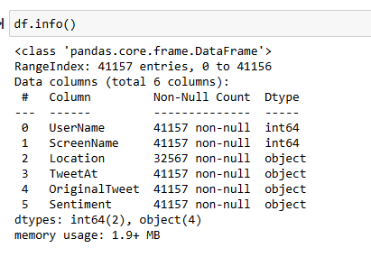
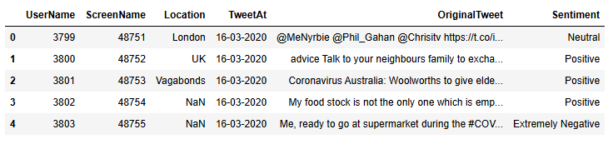
About Dataset

Slide 6
Data Exploring by using EDA:

Slide 7
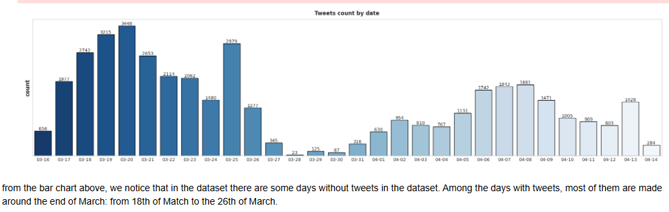
Number of tweets per day :

Slide 8
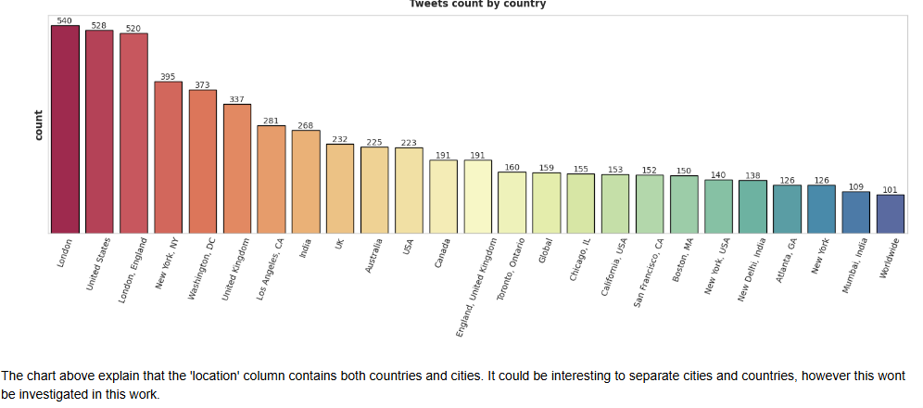
Number of tweets per Country & City

Slide 9

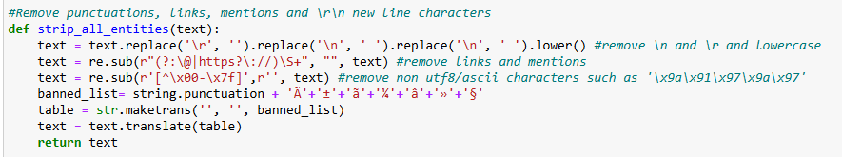
Data Preprocessing

Slide 10
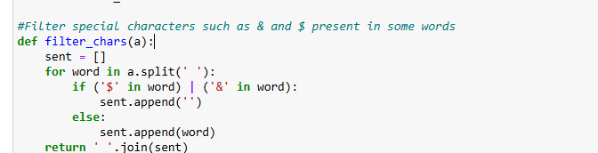


Slide 11
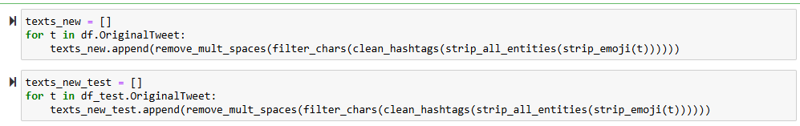
Applying the functions on Training & testing Data

Slide 12
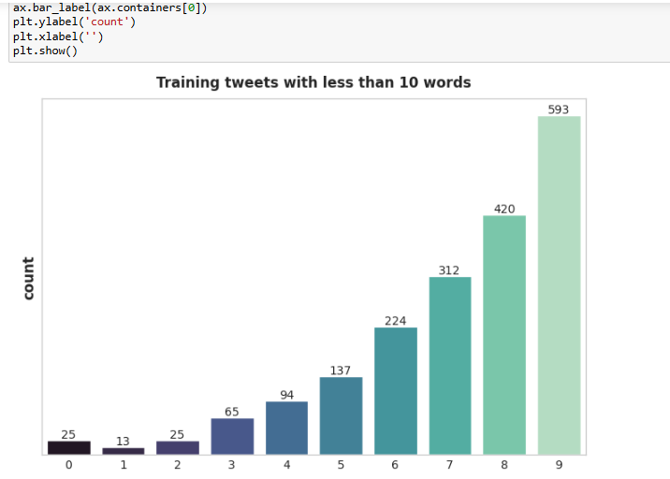
Let’s get the tweets with words less than 10

Slide 13
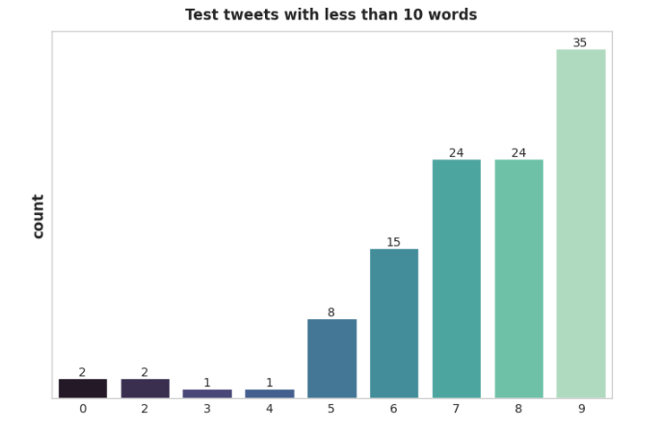
As we can see, there are lots of cleaned tweets with 0 words: this is due to the cleaning performed before. This means that some tweets contained only mentions, hashtags and links, which have been removed. We will drop these empty tweets and also those with less than 5 words.

Slide 14
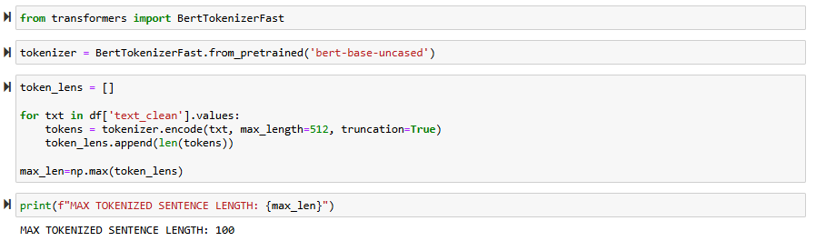
Performing Tokenization :

Slide 15
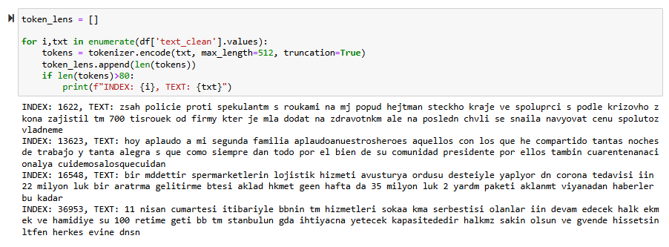
Let’s check the sentences with more than 100 words
These sentences are not in english. They should be dropped.

Slide 16
Let’s check the sentences with more than 100 words
These sentences are not in english. They should be dropped.

Slide 17
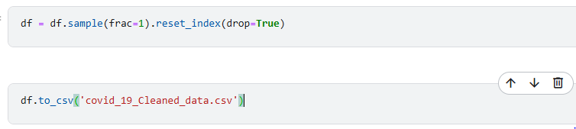
Data shuffling & reset the index
.

